Slide 1


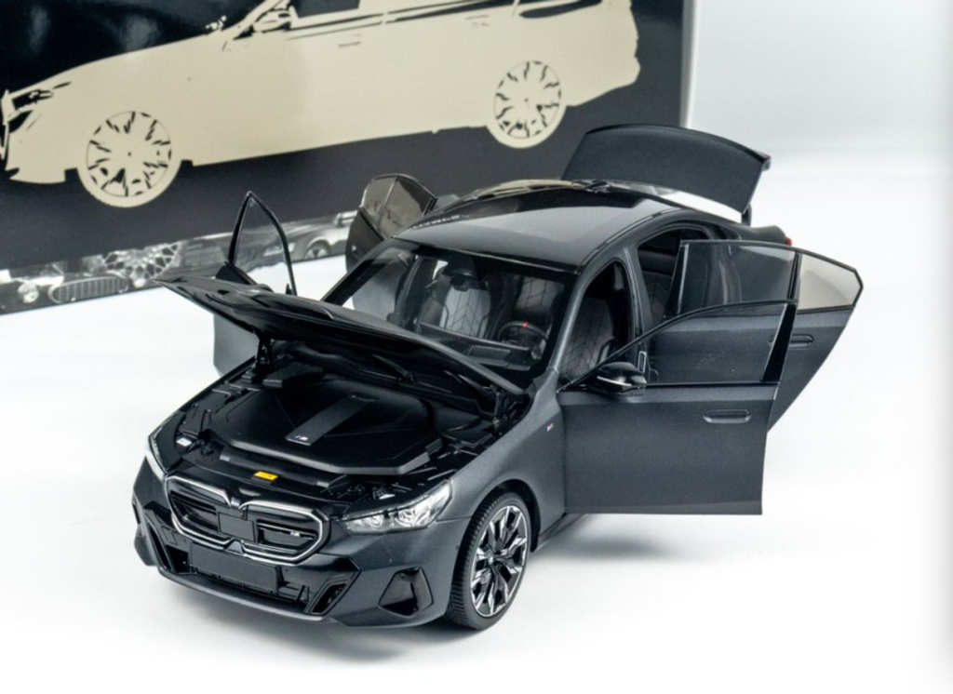


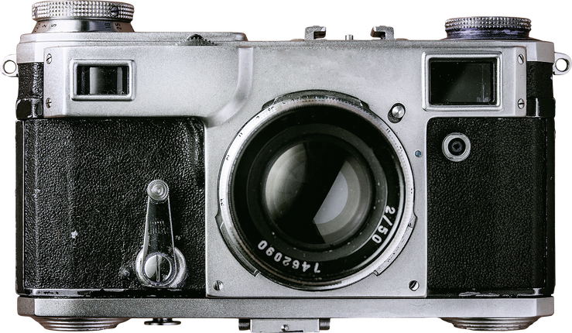

Toy Business Model Analysis
Analyst: Hung Pham
hungpham.tns@gmail.com

Slide 2


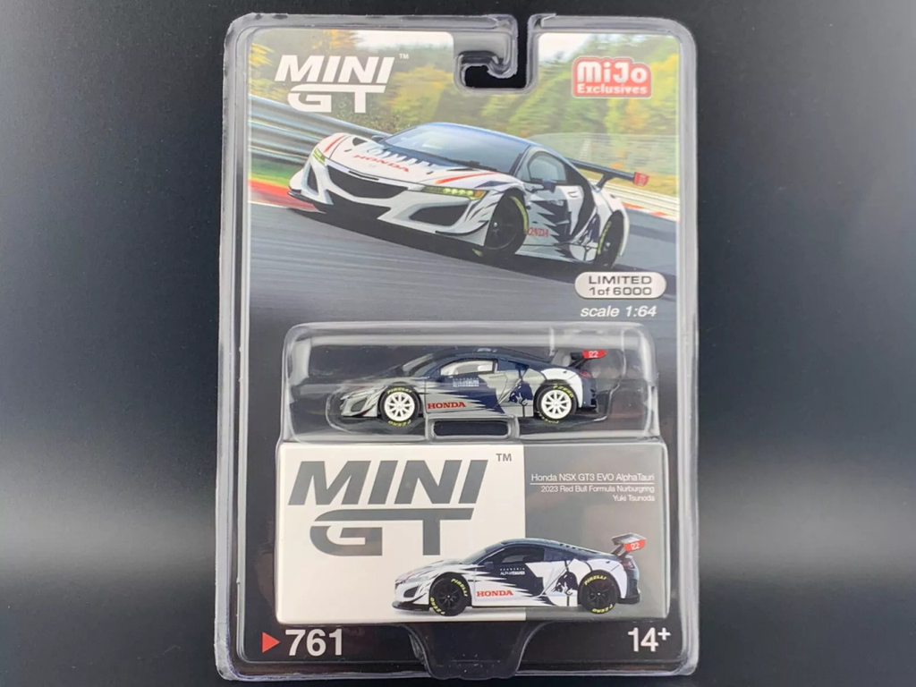

Time
Overview of the analysis
Information collected from 2003 to the second quarter of 2005
7 branches worldwide
We have 2 branches in Europe, 3 branches in North America (USA) and the remaining 2 branches in Japan and Australia.
Customer
We have 98 customers, mainly located in Europe and North America.
Product
7 product lines, of which classic and vintage are the 2 product lines that bring in the highest revenue

Slide 3


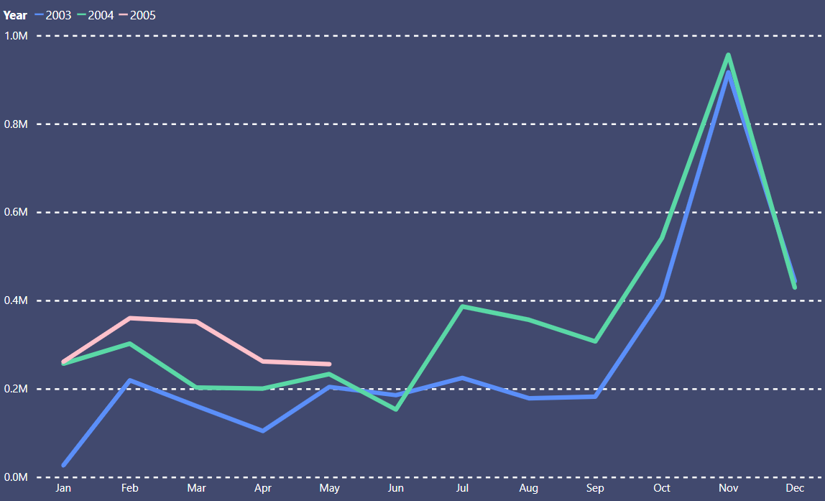


Total monthly revenue by year

Slide 4
 | Country | Total Order | Revenue
Paris | France | 32,475$ | 2,957,164.75$
San Francisco | America | 15,264$ | 1,369,194.92$
NYC | America | 11,388$ | 1,072,619.47$
Boston | America | 9,103$ | 835,882,33$
Lodon | England | 14,495$ | 1,324,325.9$
Sydney | Australia | 11,750$ | 1,004,191.86$
Tokyo | Japan | 4,923$ | 457,110.07$

Slide 5
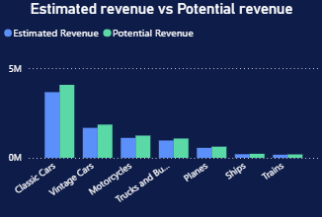
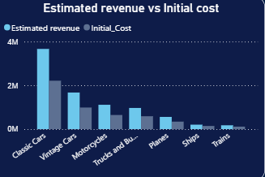
Estimated Revenue vs Potential Revenue | Estimated Revenue vs Initial Cost

Slide 6

Customers?
Where?
Who is buying? Where are they coming from?
Are they coming back?
Customer behavior
Products?
Which product lines are selling well? Which product lines are slowing down?
What is the percentage of products that are popular?
Which product lines/products should we focus on?

Slide 7


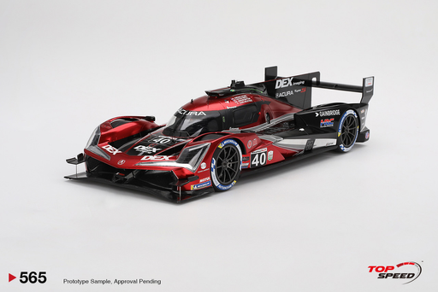
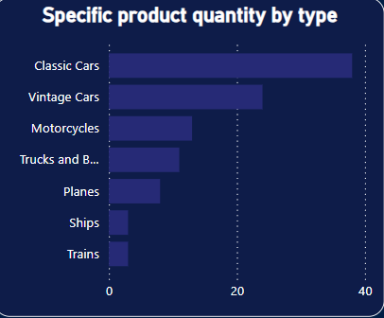
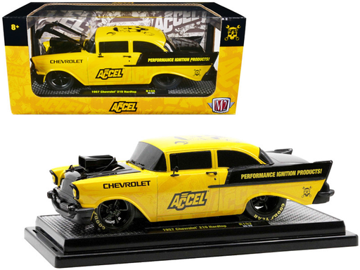

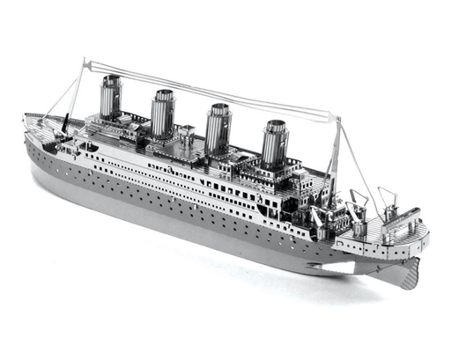
Products
100 Products
The largest number of imported products belongs to the Classic Car line (38), followed by the Vintage line(24).
Quantity Ordered & Revenue by Product Scale
Classic, Vintage: 1:18, 1:24.
Motocycle: 1:24, 1:32
Truck: 1:18, 1:32
Ship, Train, Plane: 1:24 and 1:72 scale
Import price vs.Selling price (Avg)
(Avg) Import price of 1 product: 54,26$
(Avg) Selling price of 1 product: 89.95$

Slide 8
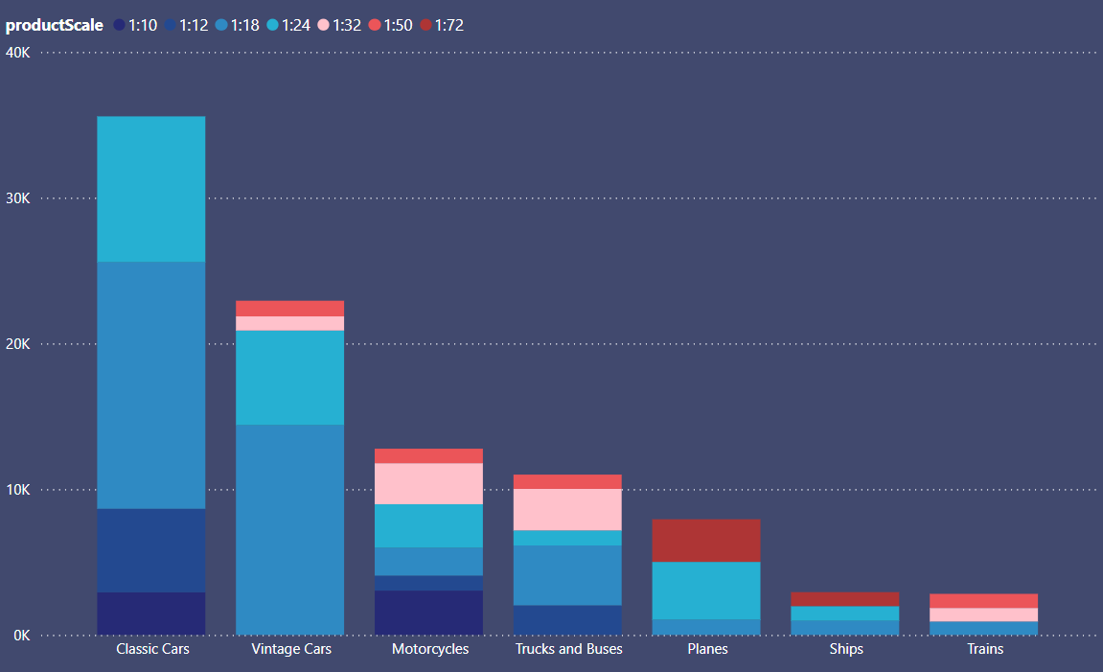
Total of quantity ordered by product scale

Slide 9
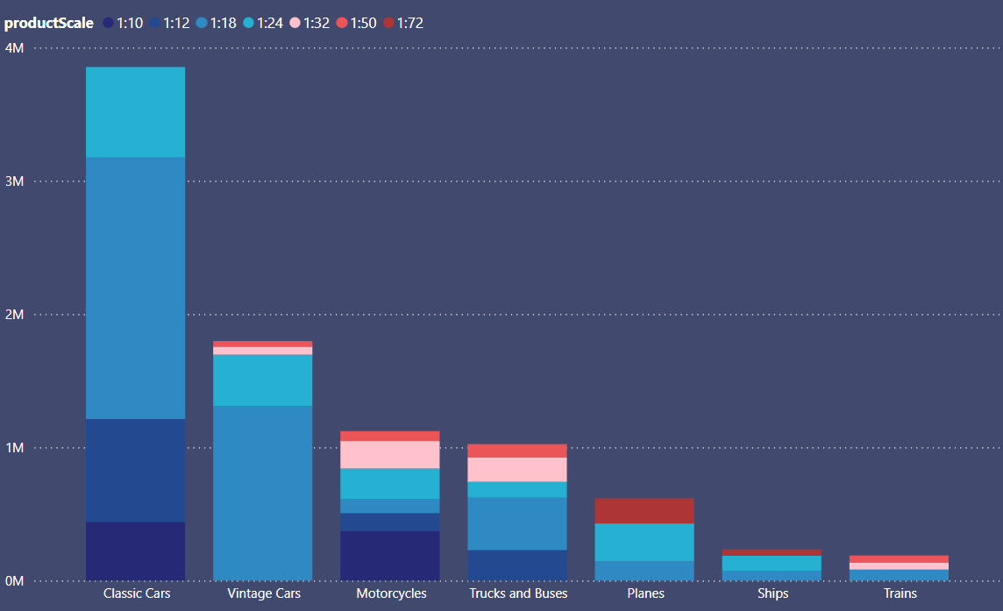
Total of Revenue by product scale

Slide 10

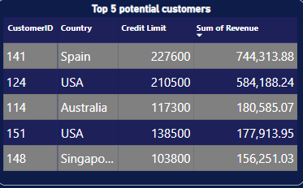


Customers
98 customers. 98,98% RCR
Customers are mainly concentrated in Europe(45) and North America(38).
Customers Segment
Low Group(25)
Avegare Group(55)
High Group(16)
Vip Group(2)
Potential Customers
These are customers in 2 segments: high-end group and VIP group. Among them, there is 1 customer from Australia.

Slide 11
 | Number of customers | Credit Limit | Total Ordered (Avg) | Products per Ordered (Avg) | Revenue
Vip Group | 2 | > 177,975$ | 20 | 369 | 1,328,502.12$
High Group | 16 | <= 177,975$ | 3 | 457 | 1,883,241.72$
Average Group | 55 | < 108,899$ | 3 | 323 | 4,753,952.10$
Low Group | 25 | <= 62,850$ | 3 | 192 | 1,094,793.36$

Slide 12
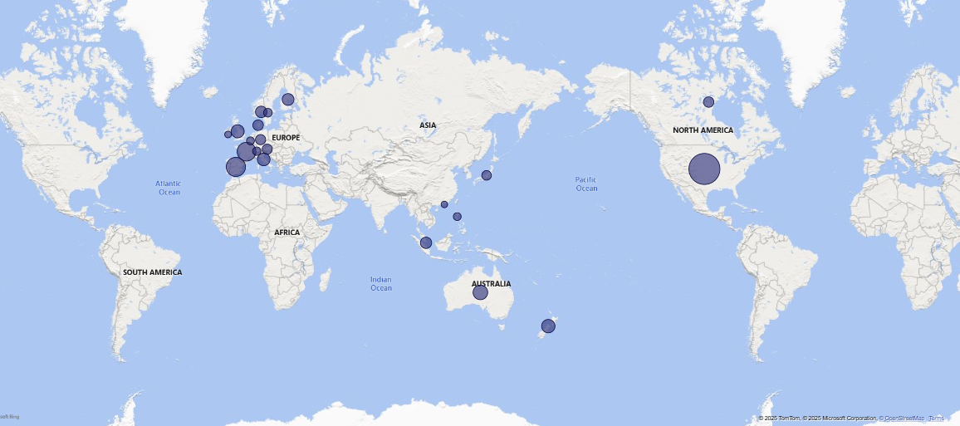

Slide 13
SALE & ORDER
Outstanding business situation
Early first and second quarter (during the period: 2003-2005)
Lowest in late Q2 and Q3. Highest in Q4 (2003 - 2004)
Selling price is lower than suggested retail price.
The number of products sold is significantly lower than the number of products imported.
Classic and Vintage are the two best-selling product lines
Paris is the branch with the highest sales performance.
INSIGHTS

Slide 14
Customers
Most customers come from Europe and North America.
Customers in the "Average Group" are the most numerous, followed by the "Low Group." The key customer groups to focus on are the "High Group" and "VIP Group."
INSIGHTS
Products
Classic and Vintage are the product lines with the highest number of imported units.
The sales volume and revenue ratio of product lines are primarily 1:18 and 1:24. For special product lines, the ratios are mostly 1:24 and 1:72.
Products with high sales volumes do not necessarily generate high revenue!

Slide 15
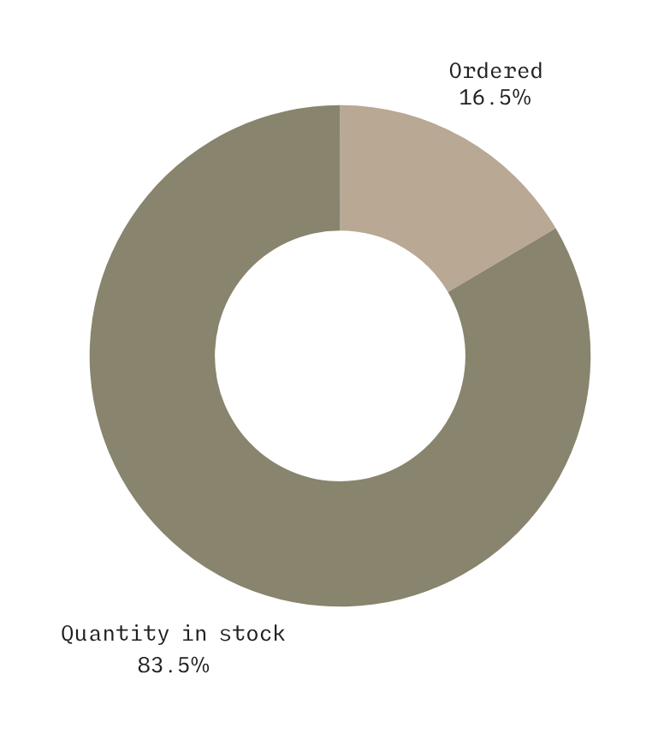
Problem?
We have sales. But the business situation is problematic:
- The number of orders only reached 310 in 2.5 years
- The total number of products sold only accounted for 16.5%.
- For the best-selling car line "Classic Car", the total number of products sold only accounted for 13.37% (34K/ 253K)

Slide 16


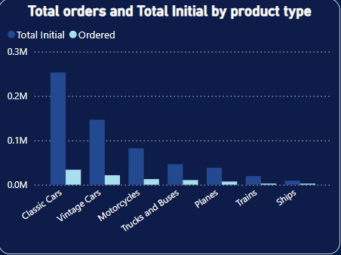
Problem?
Total Ordered
310
Total number of products ordered
99,398
Total initial products
602,847

Slide 17

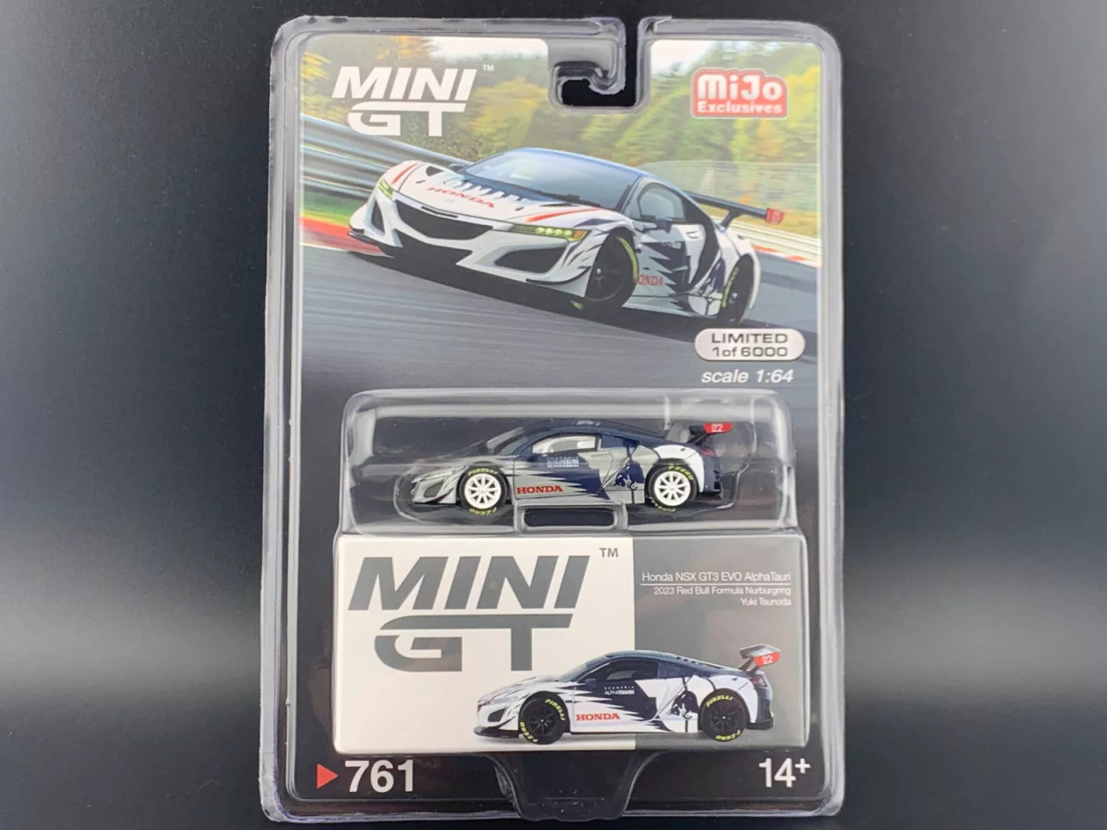

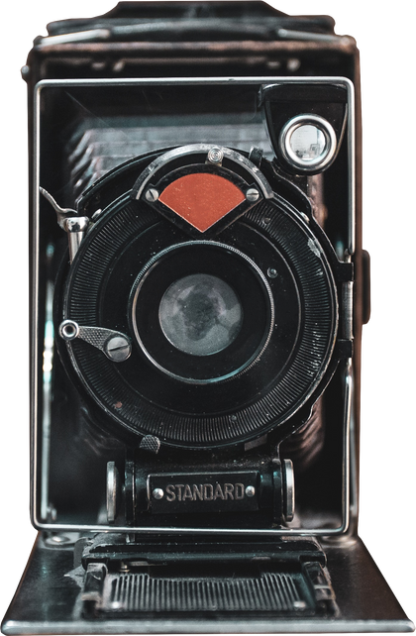
Solutions
Expanding the market in Europe
Boosting Marketing in Q2 & 3 to increase sales
Reducing selling prices
Focusing on products with good sales in each line, each branch

